Slide 1

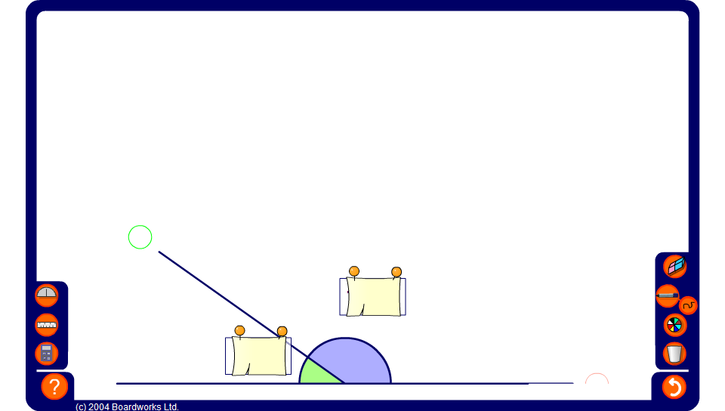


Angles on a straight line
Notes:
Use this activity to demonstrate that the angles on a straight line always add up to 180°.
Hide one of the angles and ask pupils to work out its value. Add another angle to make the problem more difficult.

